Slide 1
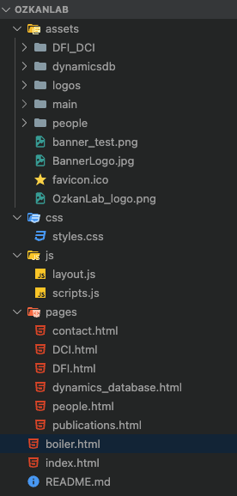
All of the pictures are located in assets folder
Css contains the styling of the content of the website - the text, images, videos, etc.
Js cantains scripts for website functions.
Layout.js loads the navigation and footer to all webpages
Pages folder contains html for each content page on the Ozkanlab website Index.html is the landing page aka “Home” for the webpage boiler.html contains the navigation,header and footer. They are loaded on every page using the layout.js.

Slide 2
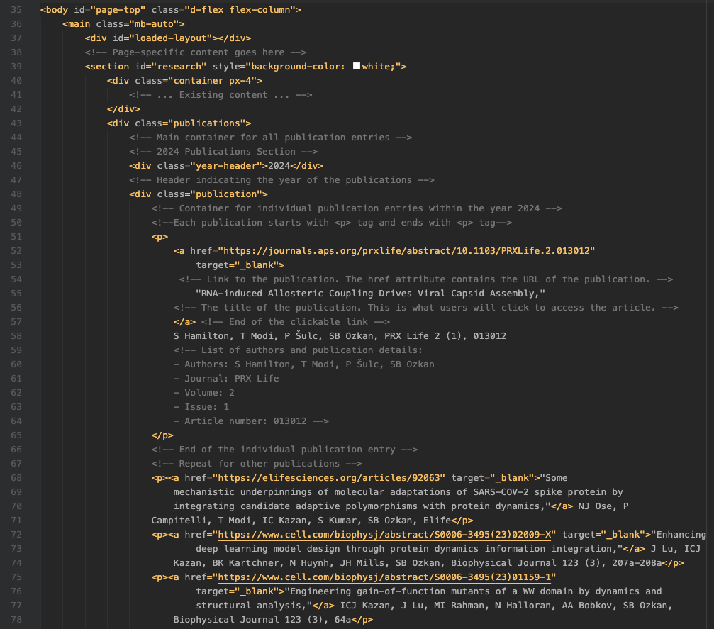
PUBLICATIONS
This is the main container for all the content that you see on the webpage. The id and class attributes are used for styling and scripting.
This is the main container for all publication entries.
This is a header indicating the year of the publications.
<p>...</p>: Each publication starts and ends with a <p> tag.
Inside the <p> tag, there’s an <a> tag which contains the URL of the publication (href attribute)
the title of the publication which will appear clickable (the text inside the <a> tag).
After the <a> tag, there’s a list of authors and publication details.
This is a container where each individual publication entries within the year 2024 are located.

Slide 3
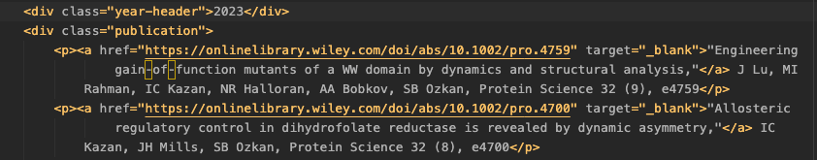
<a href=”[insert the link to the publication website]” target=“_blank”>
List as publications for 2024 with the order it appears on screen
the title of the publication
1st Publication
list of authors and publication details.
2nd Publication
Each entry that starts with <p> is a different publication
3rd Publication
4th Publication
Example snippet for publications within year 2023

Slide 4
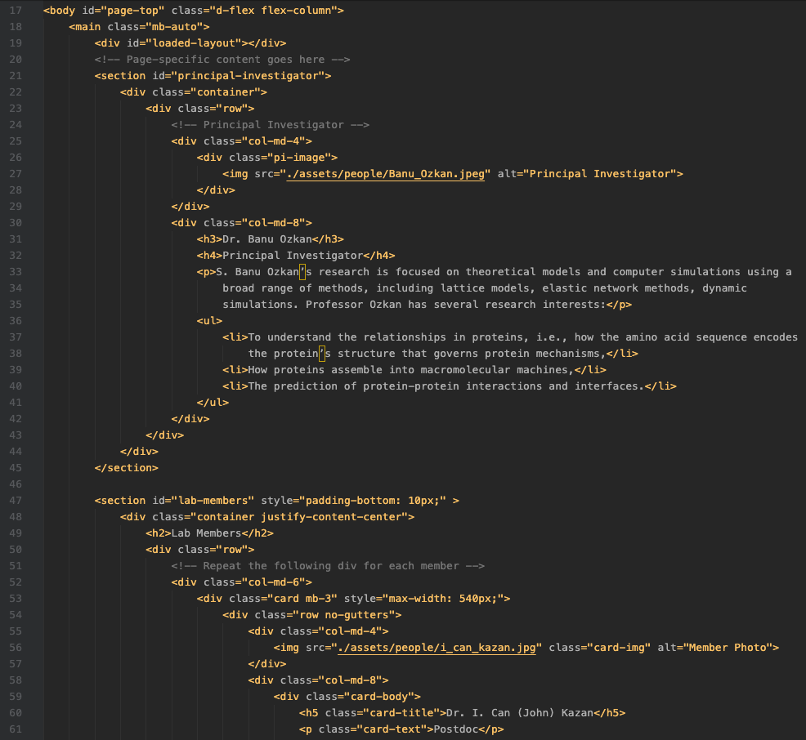
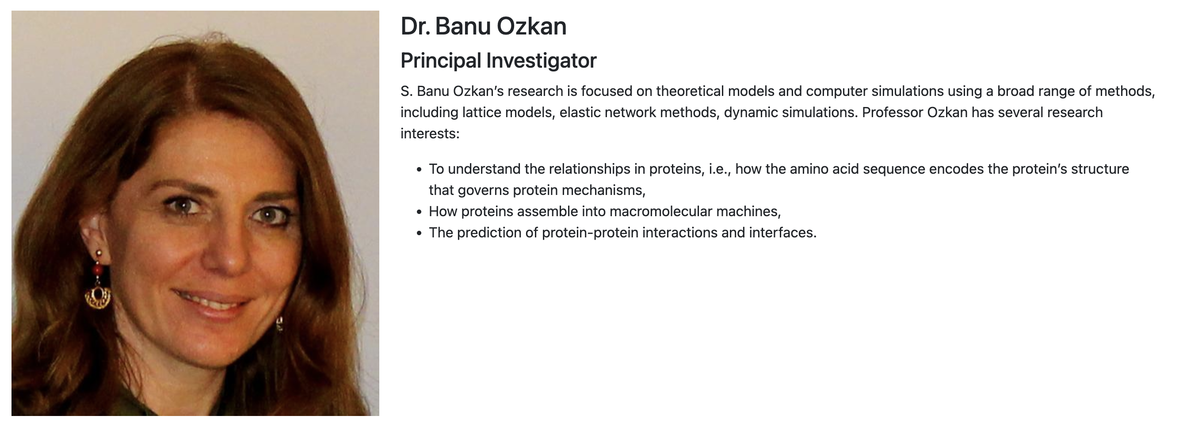

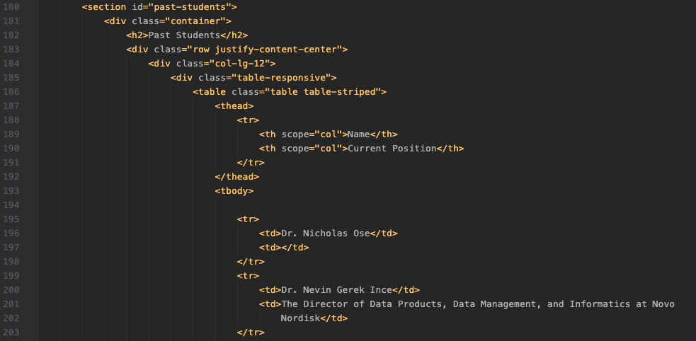
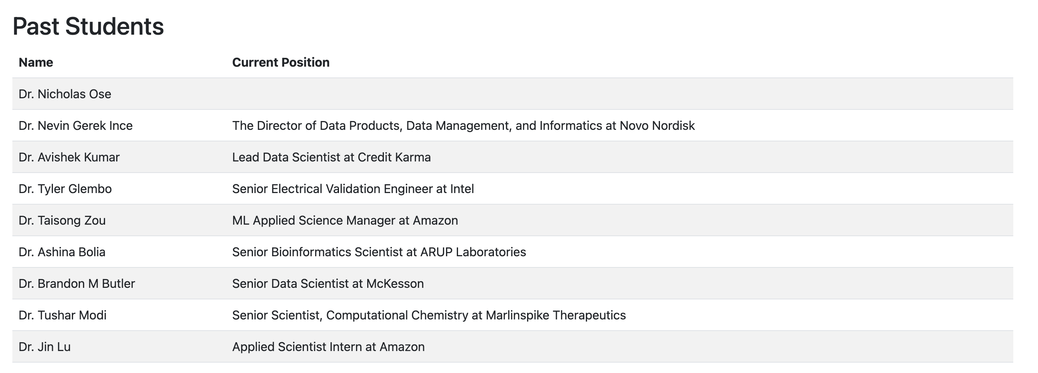
PEOPLE

Slide 5
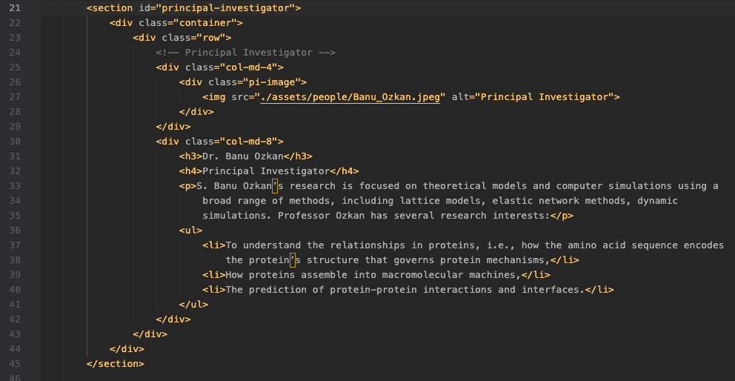
PEOPLE
<div class="col-md-4"> and <div class="col-md-8">: These are div tags with class names that likely come from Bootstrap grid system. “col-md-4” means the width of this div should be 4 out of 12 columns. Similarly, “col-md-8” means this div should take up 8 out of 12 columns on medium or larger screens.
<h3>Dr. Banu Ozkan</h3>: This is a h3 tag. It’s a heading tag, and the number (3 in this case) indicates the level of the heading. A lower number indicates a higher level (and generally larger and more important text).
<p>: This is a paragraph tag. It’s used to define a paragraph of text.
<ul>: This is an unordered list tag. It’s used to define a list of items.
<li>: This is a list item tag. It’s used to define an item in a list. In this case, is a list of research interests.

Slide 6
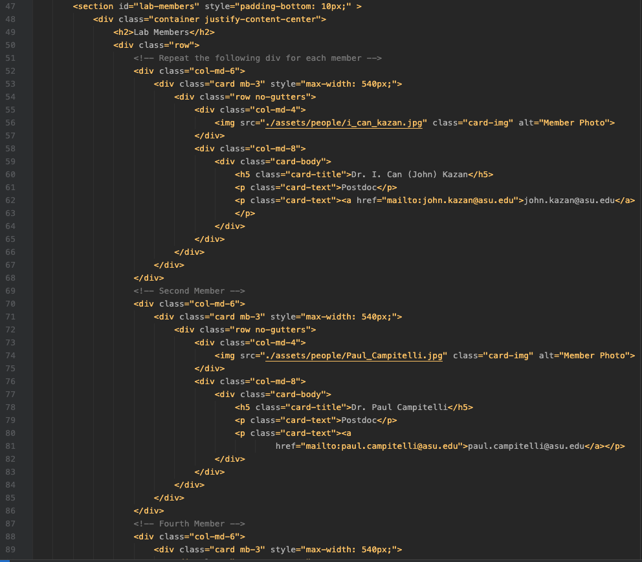
PEOPLE
1st Member
2nd Member
3rd Member

Slide 7
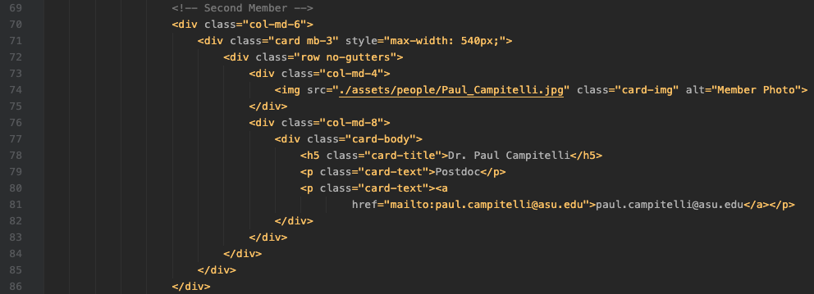
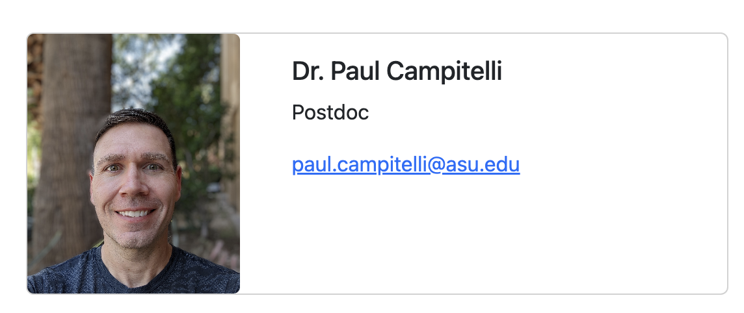
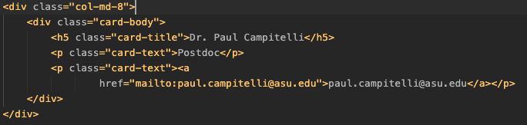


PEOPLE
image
content
<p class="card-text">Postdoc</p> and <p class="card-text"><a href="mailto:paul.campitelli@asu.edu">paul.campitelli@asu.edu</a>
</p>: These are p tags, used to define paragraphs of text. The class attribute is used to add predefined styles to the paragraphs. The <a tag defines a hyperlink, which is used to link from one page to another.
The href attribute holds the URL of the page the link goes to.
If the href attribute begins with “mailto:”, it opens the user’s email program to let them send a new email.
mailto: Link to the email
Text displayed on the page
This is an img tag. It’s used to embed images in the document. The src attribute holds the image location, the class attribute is used to add predefined styles to the image, and the alt attribute holds text to be used if the image cannot be displayed.
/assets/people/Paul_Campitelli.jpg is a relative path to an image
“ . ” This refers to the current directory.
/assets/people/: This is a path to a subdirectory named people inside a directory named assets.
Paul_Campitelli.jpg: This is the name of the image file.

Slide 8
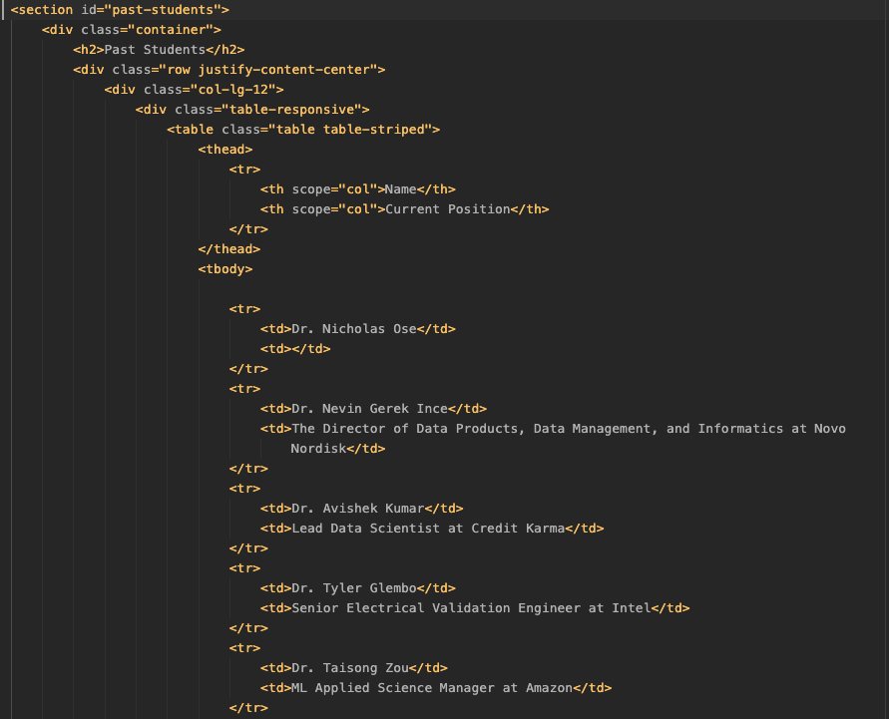
PEOPLE
Create Table
Define name of columns
<tbody>
Populate the table
</tbody>
Fill 1st column
Fill 2nd column
Add more row by using <tr> tags

